Slide 1
MASK MANDATES vs TRAFFIC ACCIDENTS
Did mask mandates affect the number of traffic accidents in NY and GA between April 10 and December 31, 2020?
Data sourced from the CDC (mask mandates) & Kaggle (traffic accidents across US).

Slide 2
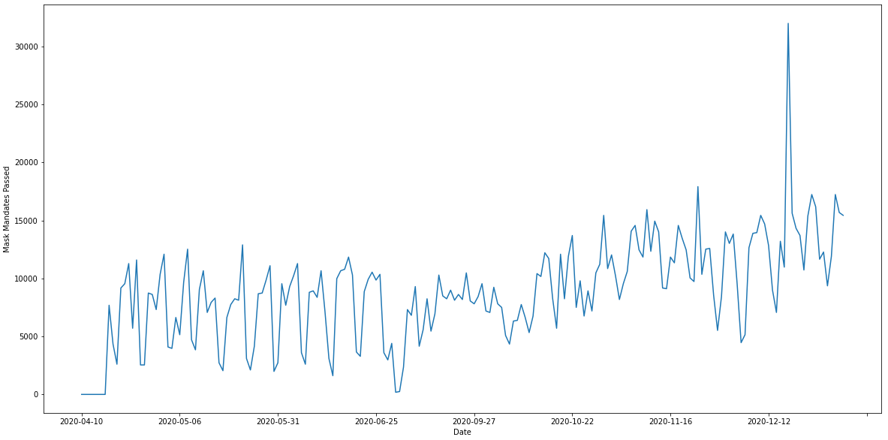
MASK MANDATES PER DAY IN NY
While NY State began implementing government mask mandates as of April 15, 2020, there was no data by way of passed ordinances indicating that GA implemented mask mandates through the end of 2020.

Slide 3
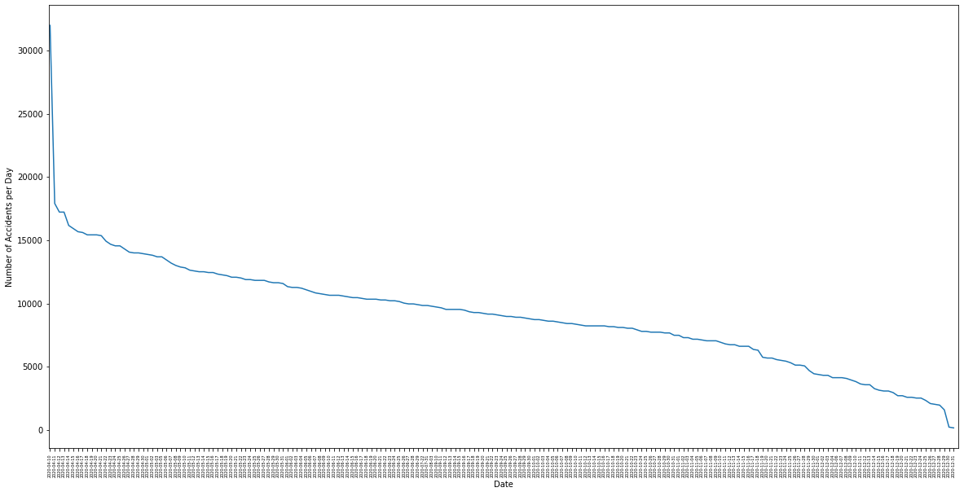
NUMBER OF ACCIDENTS PER DAY IN NY
Between April 10 and December 31, 2020, traffic accidents in NY State showed a downward trend as state-wide mask mandates increased.

Slide 4
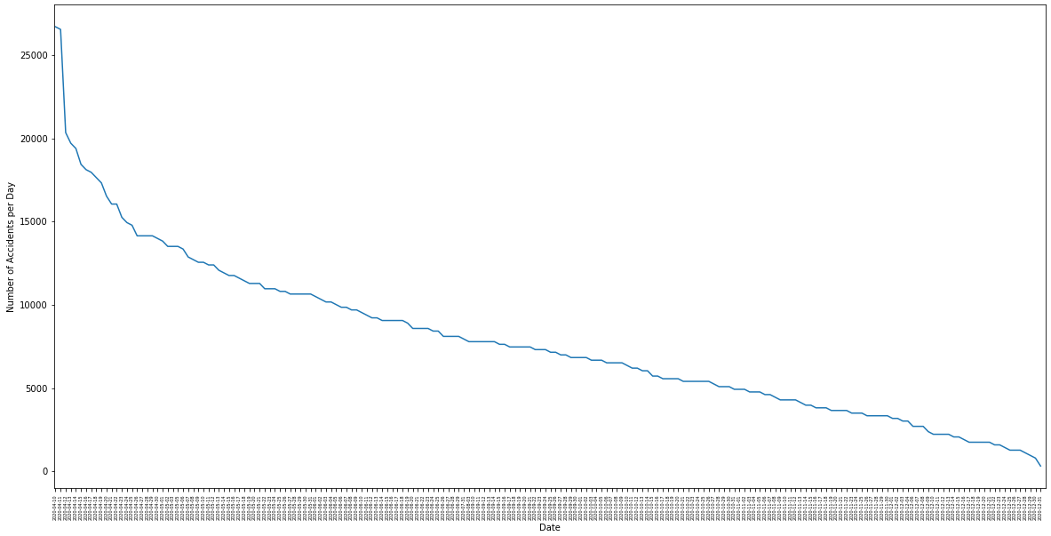
NUMBER OF ACCIDENTS PER DAY IN GA
Between April 10 and December 31, 2020, traffic accidents in GA State showed a downward trend despite the lack of mask mandates.

